Slide 1
Naklonená rovina
A
Kladkostroj
Miroslav Tomaštík

Slide 2
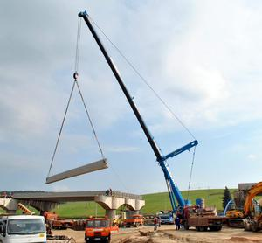

Slide 3
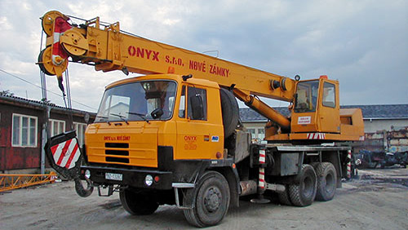

Slide 4

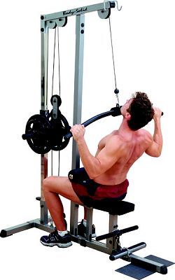
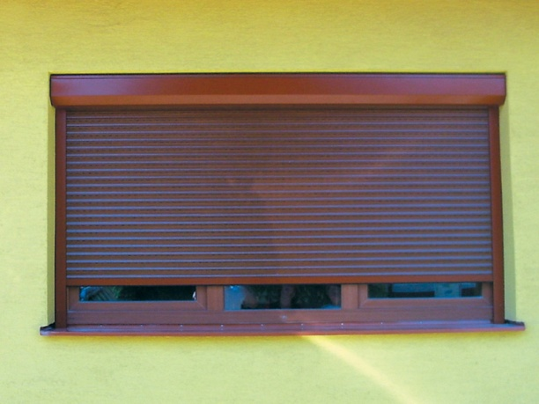

Slide 5
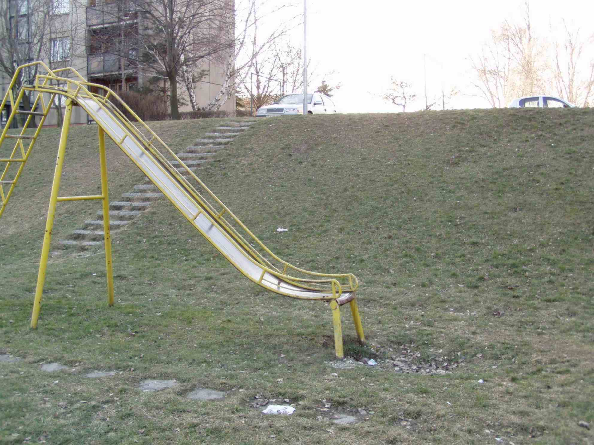
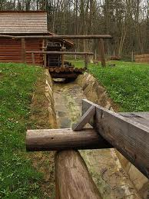
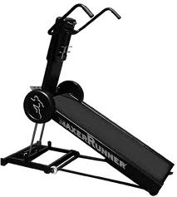
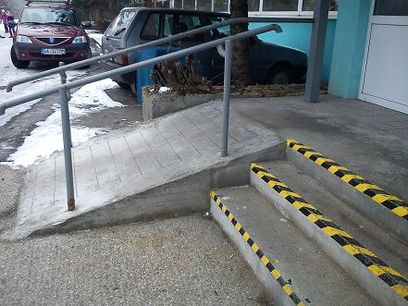

Slide 6
http://www.google.sk/search?hl=sk&rlz=1C2SKPL_enSK451SK456&q=naklonen%C3%A1%20rovina%20pr%C3%ADklady&bav=on.2,or.r_qf.&bvm=bv.44158598,d.Yms&biw=1280&bih=546&ie=UTF-8&sa=N&tab=iw&ei=K_RPUZTYK4eRtQaV3YGACQ#hl=sk&rlz=1C2SKPL_enSK451SK456&sclient=psy-ab&q=naklonen%C3%A1+rovina+p%C3%A1ka+kladka&oq=naklonen%C3%A1+rovina+&gs_l=serp.1.3.0l4.7339.7339.0.11482.1.1.0.0.0.0.166.166.0j1.1.0...0.0...1c.1.7.psy-ab.1N20CSSmb9c&pbx=1&bav=on.2,or.r_qf.&fp=5d49d14d3c869e25&biw=1280&bih=546
http://www.google.sk/search?q=naklonen%C3%A1+rovina+p%C3%A1ka+kladka&hl=sk&rlz=1C2SKPL_enSK451SK456&tbm=isch&tbo=u&source=univ&sa=X&ei=vPRPUebtOpDXsgb9nYDACw&ved=0CD0QsAQ&biw=1280&bih=546#imgrc=CoHUfrh0NEhTwM%3A%3BcTp-m-qzi6xvvM%3Bhttp%253A%252F%252Fwww.ddp.fmph.uniba.sk%252F~demkanin%252Fsmyklavka1.JPG%3Bhttp%253A%252F%252Fwww.ddp.fmph.uniba.sk%252F~demkanin%252FSPSP1.htm%3B1984%3B1488

